Slide 1
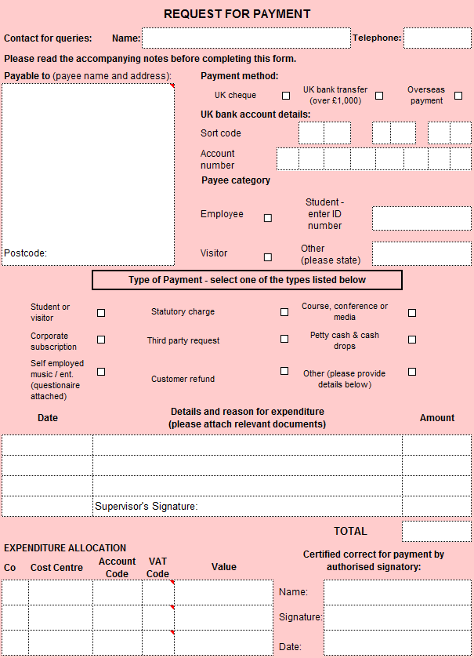
Request For Payment Forms
The Request for Payment form can be found at the link below. You will need APF2 Request for Payment (Excel).
https://www.dur.ac.uk/treasurer/local/downloadable_forms/payment_of_suppliers_trade_and_other_forms/
These are for expense claims for anyone NOT on the payroll, or those on the payroll claiming for anything other than Travel, Conferences, Accommodation & Subsistence.
Contact for Queries: This is the contact details of one of the Finance Team. Please ignore.
Payable to: Please fill in the Payee’s name and address, including a postcode. This is the person to whom the money will go, not their bank.
Bank Details: Please fill in your sort code and account number for where you want to be reimbursed. If an overseas account needs refunding, please add the Swift & IBAN number here
Details and reason for expenditure: Please give sufficient information about the expenditure. Please also give dates for the expenditure. Please use one line per expense.
Cost Centre: Enter in your cost centre or grant code.
Receipts: Please upload original copies of receipts to the form ensuring that they are of good quality otherwise your claim will be returned/rejected.
Authorised Signatory: This is for the Finance Team to sign off to authorise payment. Payment: Your form and receipts will be printed off and signed accordingly before sending to central Finance for processing.
Ideas
Ideas
Cut off dates for expenses payments can be found on the pages relating to ‘Service level agreements’

